Slide 1
Risk Management – Dynamic hedging
21st Mar 2013

Slide 2
Outline of presentation
Risk management 1-0-1
The optimal duration of cost planning
Procurement objectives
Building to a robust risk management process
Notes:
To understand how energy costs are built up, what risk is and why there is risk? To understand that it’s impossible to predict the market’s movements.

Slide 3
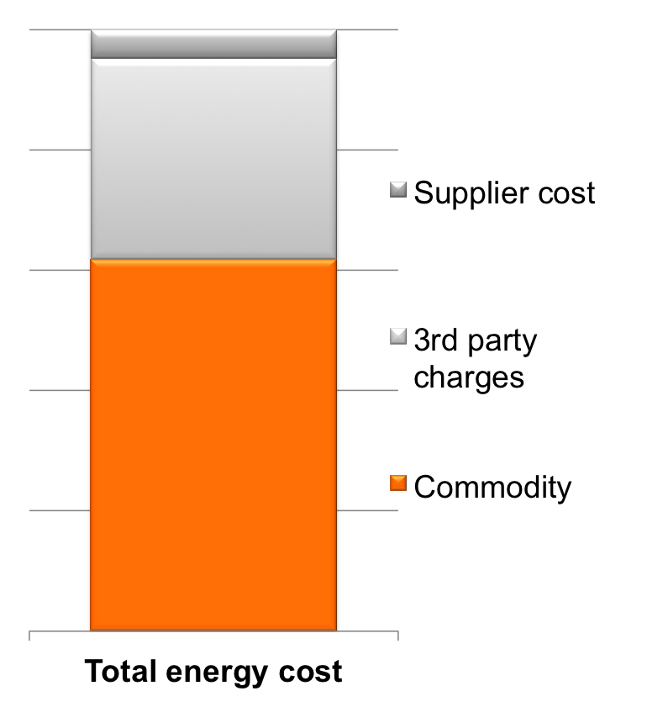
What can be risk managed?
Commodity is the biggest contributor to your energy spend
– but it is far from being the only major component.
The price is determined by the market.
Notes:
Your energy cost contains all these elements, even if they are not visible to you, i.e. on a fully inclusive unit rate.

Slide 4
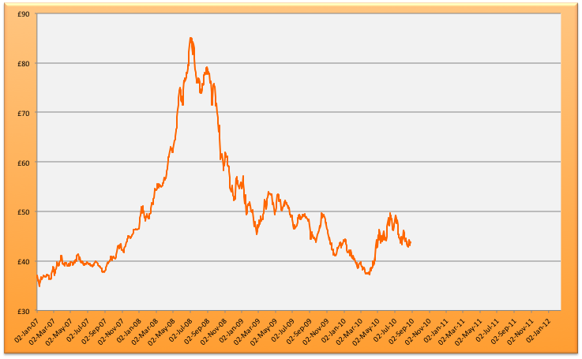
What is risk?
Risk of cost increase
Not fixed the price (but could have)
Risk of lost opportunity
Price fixed
Notes:
One type of risk is obvious: that is price increase and higher cost. It is easy to protect against it, just fix as long as you can. However, there is another risk, which is to do with buying at a price which then proves to be very high.

Slide 5
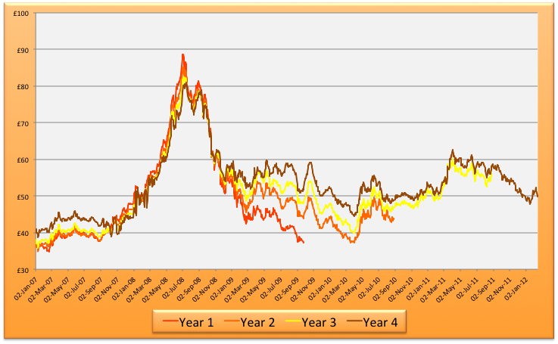
Market behaviour

Slide 6
A risk averse company (?)
Notes:
It is an illusion that a sequence of fixed price contracts is a risk averse strategy. As illustrated here, you are likely to have just a blurred vision of the market, and how you as the buyer will be judged year on year, highly depends on luck. You will be a bit like a trader: a good year, some average years and a really bad one. Your career depends on which order each of these occur.

Slide 7
Outline of presentation
Risk management 1-0-1
The optimal duration of cost planning
Procurement objectives
Building to a robust risk management process

Slide 8
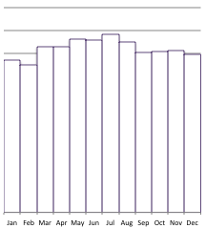
How long do you want to remain in business?
Year 1
Year 2
Year 3
Energy requirement (kWh)
Future years
Notes:
Theory - practice

Slide 9
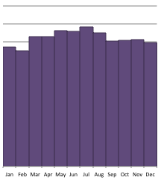
Example: Fixed price for 1 year
Year 1
Year 2
Year 3
Energy requirement (kWh)
Future years
Supply contract for 1 year.
Price fixed for one year, but no ability to change your strategy.
Price is linked to market for all future years.
No contract, price linked to market
Contracted but price linked to market
Contracted and
price fixed

Slide 10
Example: Fixed price for 2 years
Year 1
Year 2
Year 3
Energy requirement (kWh)
Future years
Supply contract for 2 years.
Price fixed for one year, but no ability to change your strategy.
Price is linked to market for future years.
No contract, price linked to market
Contracted but price linked to market
Contracted and
price fixed

Slide 11
Outline of presentation
Risk management 1-0-1
The optimal duration of cost planning
Procurement objectives
Building to a robust risk management process

Slide 12
Risk management principles
Procurement objectives
Identify
Measure
Mitigate
Cost certainty
Performance
versus the market
A Risk Framework is needed to establish a balance
Notes:
Once we have identified, and even measured risk, we surely want to mitigate it somehow. Time to discover the connection between the two types of risk, and the conflicting nature of the two most common procurement objectives.

Slide 13
2 objectives = 2 faces of risk
Risk of cost increase
Not fixing (but could have)
Risk of lost opportunity
Price fixing
Notes:
Easy to protect against each of the objectives, but so long as the only tool you have is a fixed price contract, it’s impossible to achieve both. And because companies tend not to care only about one of those procurement objectives, this is a problem.

Slide 14
Outline of presentation
Risk management 1-0-1
The optimal duration of cost planning
Procurement objectives
Building to a robust risk management process
Notes:
But how to ensure that a flexible buying process achieves your procurement objectives, because this is really not about trading, you are not a trader, but a net consumer, so what you are doing here is managing the risk that is inherently there because you must buy the commodity on a marketplace.

Slide 15
Contract types
Fixed price
Flexible price
(fixing / unfixing)
Committed to a supplier
Fixed duration
Agreed offtake volumes
Committed to price at the point of signature
No flexibility to revise volume forecast
Ability to influence price and manage risk
Revise volume forecasts to avoid penalties
Notes:
First of all you need the tools. These tools will just give you the option to pursue a strategy different from being solely focused on cost, or competitiveness. The tools don’t give you a process, we come to that later.

Slide 16
How long do you want to remain in business?
Year 1
Year 2
Year 3
Energy requirement (kWh)
Future years
Treat contractual coverage and commitment to price (fixing) separately.
Contract type ≠ Strategy.
No contract, price linked to market
Contracted but price linked to market
Contracted and
price fixed
Notes:
Contract type does not equal strategy.

Slide 17
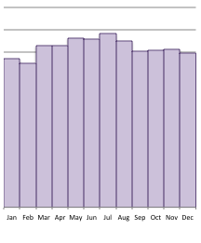
Contract type: Flexible contract for 3 years – at the start
Year 1
Year 2
Year 3
Energy requirement (kWh)
Future years
Supplier appointed for 3 years.
At the time of signing the contract, price is still linked to market.
A flexible contract enables you to fix as much as you want, for as long as you want.
No contract, price linked to market
Contracted but price linked to market
Contracted and
price fixed

Slide 18
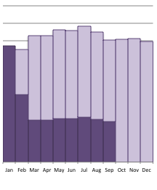
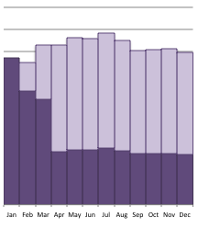
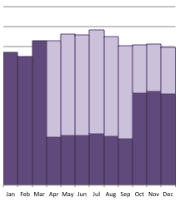
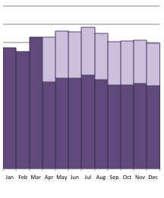
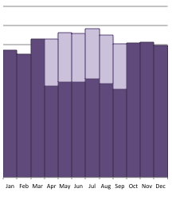
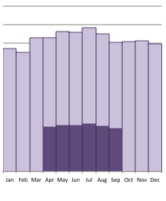
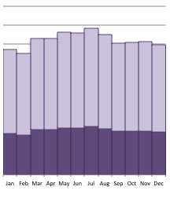
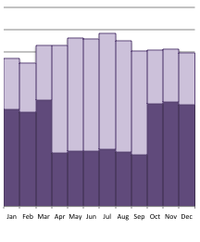
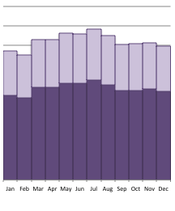
Contract type: Flexible contract for 3 years – ongoing
Year 1
Year 2
Year 3
Energy requirement (kWh)
Future years
A flexible supply contract enables you to align the hedged % of your future requirements with changing market conditions.
Your strategy will determine what your hedged % will be.
No contract, price linked to market
Contracted but price linked to market
Contracted and
price fixed
Notes:
You can pitch your cover level depending on the relative importance of each procurement objective, and also the opportunities offered by the market at the time. Both the objectives and the market changes, so it is only natural that you will want to change your hedged % over time as well. In our process it happens dynamically.

Slide 19
Introducing a risk limit
Risk Limit:
Controlled risk of cost increase
Not fixing (but could have)
Some risk of lost opportunity
(because we didn’t take
full risk in the first place)
Notes:
This is the key thing to risk management: how to articulate a strategy so it translates into day-to-day action?
- We have seen that it’s not possible to satisfactorily predict the market so we cannot trust neither advise nor sentiment blindly.
- We also need a governance process that different stakeholders in the business understand: we have to speak the language of numbers as opposed to vague categories of appetite to risk.

Slide 20
Dynamic risk mgt – trading activity
$
Risk Limit
Market value
Baseline
time
Client’s energy cost
Buy
Sell
Notes:
20
How does the risk limit then governs everyday action?
Once you have a strategy and the market starts moving, and you have daily visibility of where you stand, it is suddenly very clear what action you need to take in order to remain compliant with the strategy. You can also justify these transactions based on the strategy, approved by a wider forum, and this removes both the emotive nature of the decisionmaking, and also

Slide 21
Case example
_{Following our} risk management process we turned this 2007 position…….
Into this.................
_{Market Price}
_{Risk Limit}
_{Fixed Price}
_{Client’s Price}
Notes:
₂₁

Slide 22
Conclusion:
Steps towards a robust risk policy
Identify risk
Measure risk
Define your objectives
Put the necessary tools in place.
Put the necessary support in place.
Put the necessary governance in place.

Slide 23
Thank you
Gabor.Balkanyi@ems.schneider-electric.com

